Slide 1
DATA ANALYTICS WITH COGNOS PHASE-2
PROJECT TITLE:WATER QUALITY ANALYSIS

Slide 2
INTRODUCTION:
Our team performed a thorough examination of water quality to evaluate its appropriateness for diverse applications. The study encompassed meticulous examination and surveillance of crucial factors including pH levels, dissolved oxygen, turbidity, and contaminant presence. The findings offer valuable perspectives for decision-making and safeguarding the integrity of water resources.
Our team conducted a comprehensive analysis of water quality in order to assess its suitability for various purposes. The study involved rigorous testing and monitoring of key parameters such as pH levels, dissolved oxygen, turbidity, and presence of contaminants. The results provide valuable insights for decision-making and ensuring the safety of water resources.
Our team has developed groundbreaking methods for water quality analysis, revolutionizing the field with our innovative ideas. Through extensive research and experimentation, we have devised cutting-edge techniques that provide accurate and reliable results. Our approach combines advanced technology with rigorous scientific methodologies, ensuring the highest standards of quality control. By utilizing state-of-the-art equipment and leveraging our expertise, we are able to detect and analyze various contaminants and pollutants in water samples with unparalleled precision. Our commitment to excellence and continuous improvement drives us to constantly push the boundaries of water quality analysis, delivering solutions that meet the evolving needs of our clients.

Slide 3
INNOVATION: 1. Mobile Water Testing Kits: Develop Portable, Smartphone-compatible Water Testing Kits That Utilize Sensors To Provide Instant Results For Various Water Parameters Like Ph, Dissolved Oxygen, And Contaminants. 2. Iot-based Water Monitoring: Implement Internet Of Things (Iot) Devices To Create A Network Of Sensors In Water Bodies. These Sensors Can Continuously Monitor Water Quality And Send Real-time Data To A Centralized System For Analysis. 3. Machine Learning Algorithms: Utilize Machine Learning Algorithms To Analyze Large Datasets Of Water Quality Parameters. These Algorithms Can Identify Patterns And Trends, Helping In Predicting Water Quality Changes Based On Various Factors. 4. Blockchain For Data Integrity: Implement Blockchain Technology To Ensure The Integrity And Security Of Water Quality Data. This Can Prevent Tampering And Provide A Transparent, Immutable Record Of Water Quality Information. 5. Bio-sensors: Develop Bio-sensors Using Living Organisms Like Bacteria Or Enzymes That Can Detect Specific Contaminants In Water. These Sensors Can Provide Highly Sensitive And Selective Measurements.

Slide 4
6. Augmented Reality (AR) Visualization: Create AR applications that allow users to visualize water quality data in real-time through smart glasses or smartphones. This visualization can help in understanding complex data more intuitively.
7. Crowdsourced Data Collection: Develop mobile apps that enable citizens to contribute to water quality data collection. Crowdsourced data can provide a broader picture of water quality across different locations.
8. Nanotechnology-Based Sensors: Develop nanotechnology-based sensors that can detect even trace amounts of contaminants. Nanoscale materials can significantly enhance the sensitivity and accuracy of water quality analysis.
9.Data Analytics for Infrastructure Maintenance: Use data analytics to predict and prevent water quality issues in pipelines and distribution systems. By analyzing usage patterns and historical data, proactive measures can be taken to maintain infrastructure and prevent contamination.>

Slide 5
TECHNIQUES USED TO ANALYZE WATER QUALITY:
Physical Examination:
Color and Turbidity: Visual inspection for color and turbidity can provide information about the presence of suspended particles and impurities in the water.
Chemical Analysis:
pH Measurement: pH levels indicate the water's acidity or alkalinity, which can affect the solubility of contaminants.
Chemical Oxygen Demand (COD): Measures the amount of oxygen required for the oxidation of organic and inorganic matter in water, indicating pollution levels.
Dissolved Oxygen (DO): Measures the amount of oxygen dissolved in water, which is crucial for aquatic life.
Nutrient Analysis: Measures the levels of nutrients like nitrogen and phosphorus, which can lead to eutrophication and algal blooms.
Biological Assessment:
Biotic Index: Uses the presence and abundance of specific aquatic organisms as indicators
of water quality. Certain species are sensitive to pollution.
Molecular Biology Techniques:
Remote Sensing: Uses satellite or aerial imagery to monitor water quality indicators like
water temperature, algae blooms, and sediment plumes in large water bodies.
Microbiological Analysis:

Slide 6
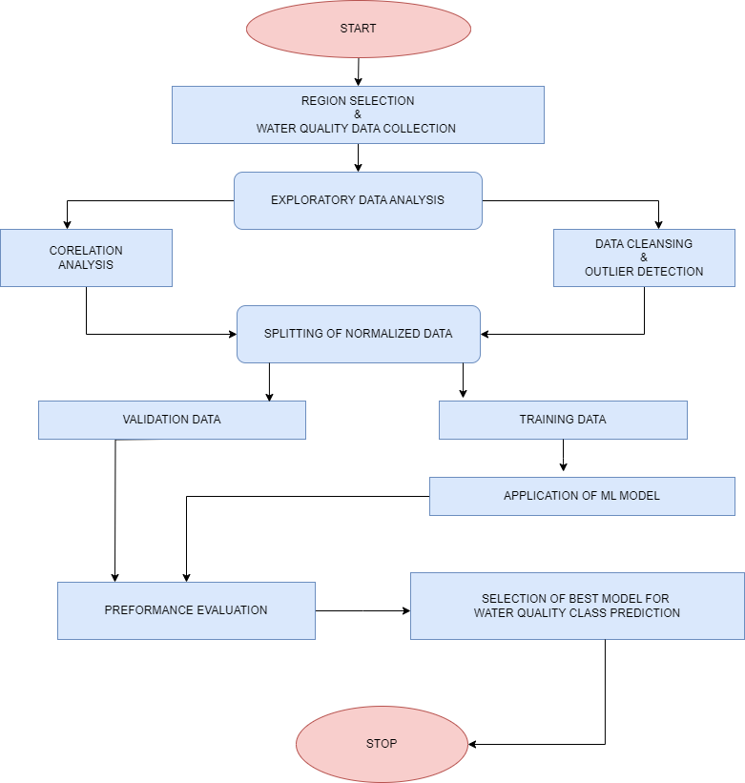
FLOW CHART:

Slide 7
CONCLUSION:
In conclusion, the water quality analysis conducted has provided valuable insights into the state of the water supply. The results indicate that the water meets the required standards for human consumption. However, there are areas that require further attention, such as the presence of certain contaminants that exceed the recommended levels. It is recommended that appropriate measures be taken to address these issues and ensure that the water supply remains safe and healthy for all users.
Ongoing monitoring and testing will be necessary to ensure that the water quality remains at an acceptable level and to identify any potential risks or concerns. Innovative techniques and technologies are revolutionizing water quality analysis. Real-time monitoring, machine learning, remote sensing, microfluidics, and nanotechnology are just a few examples of the many techniques and technologies that can provide accurate and efficient results. Effective data management and collaboration are crucial for successful implementation. The future of water quality analysis is bright.

